Slide 1

Seth’s Apothecary Database Project
Designer: Adrienne Lawson

Slide 2
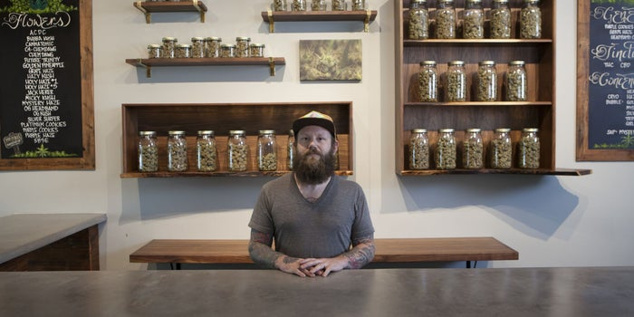
Business Outline: Seth’s Apothecary
Disabled & veteran owned medical marijuana dispensary.
Four locations throughout Attleboro & North Attleboro, Massachusetts.
In operation for 5 years.
Licensed for medical grade cultivation and sales across all locations.
Image: https://www.greenentrepreneur.com/article/329033

Slide 3

Business Case: A New Database
Image: https://it-cross.com/solutions/oracle-erp-cloud/

Slide 4
Reporting Requirements
“How many employees are listed as active?”
“How many registered patients are there?”
“What is the license expiration for Dispensary #3 (7713)?”
“How many orders has Caregiver #131775 made this month?”

Slide 5
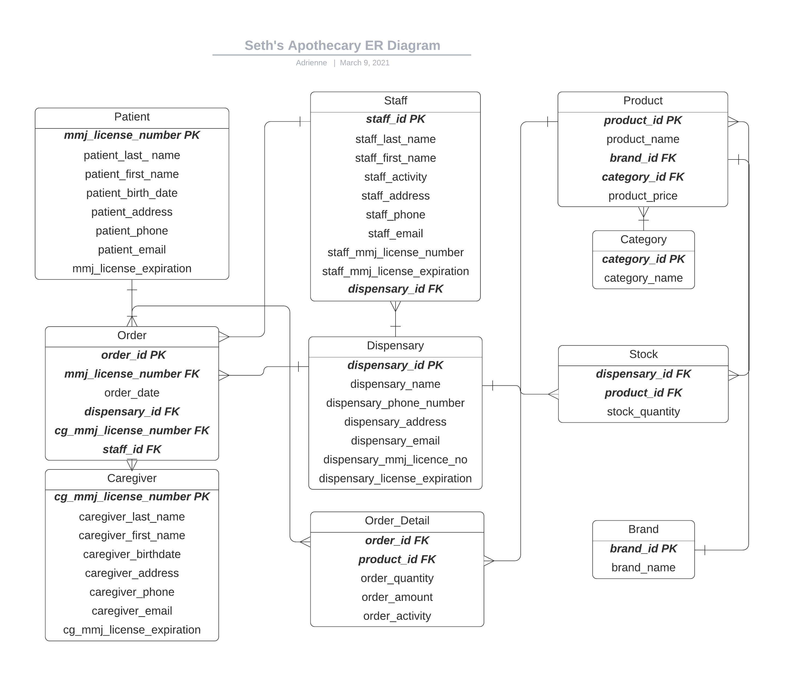
ER Diagram

Slide 6
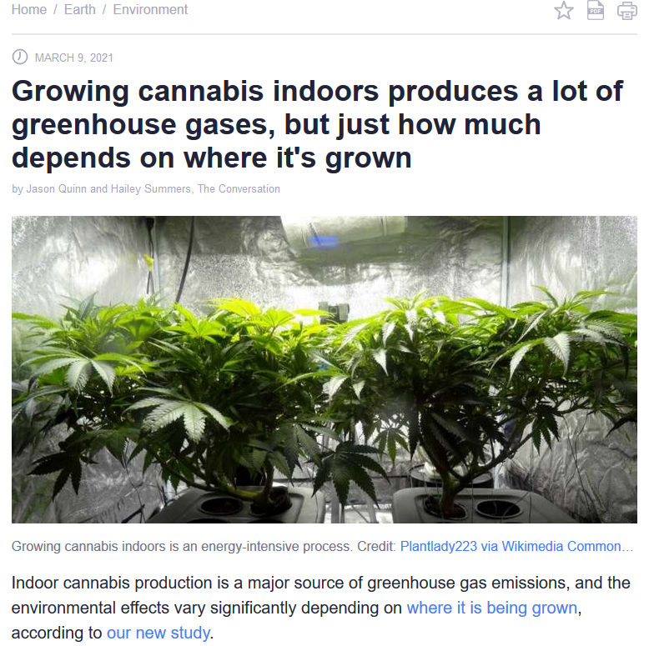
The “Future”…
Image: https://www.fool.com/investing/2020/06/21/why-us-marijuana-legalization-is-likely-on-the-way.aspx
Image: https://phys.org/news/2021-03-cannabis-indoors-lot-greenhouse-gases.html

